Slide 1
FIFA World Cup Analysis Done by: Kalluri. Gopi Kiran UNID:UMIP6266

Slide 2
agenda
Abstract 3
Proposed Work 4
Visualizing the Data 5-8
Insights And Data Analysis 9-11
Conclusion 12

Slide 3
Abstract The FIFA World Cup is one of the world's most important sporting events, with a rich history spanning over 90 years. This historical data analysis examines many aspects of the World Cup tournament, including team results, player statistics, and general trends and patterns over the years. Analyze data from past tournaments to identify the top performing teams, top players, and factors that contributed to tournament wins. It also looks at the impact of various factors such as the host country, playing conditions and the tactics used by the teams. Through this analysis, we aim to provide fans, analysts and strategists with valuable information about the FIFA World Cup and its evolution over the years. Keywords—FIFA world cup, Team results, Statistics, Trends, Patterns, Top players, Host

Slide 4
Proposed Work
Data collection: Collected sales data .
Data cleaning and preparation: Cleaned and transformed the data to ensure it was accurate, complete, and consistent.
Data modeling: Designed a data model that organized the data in a way that made it easy to analyze and visualize.
Data visualization: Used Power BI to create charts, tables, and other visualizations that presented the data in a way that was easy to understand.
Analysis and insights: Analyzed the visualizations to identify trends and insights that informed business decisions.

Slide 5
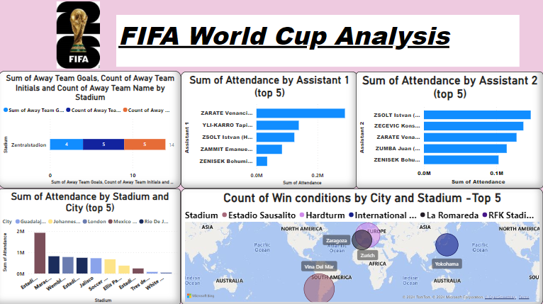
Visualizing the Data

Slide 6
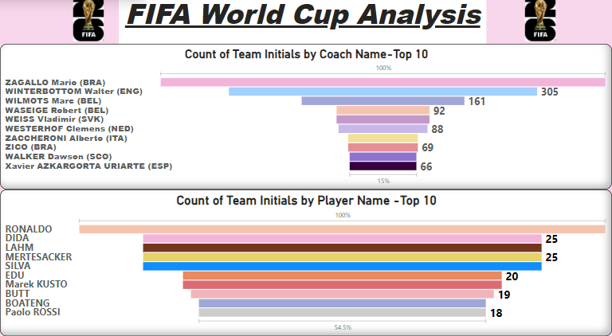
Visualizing the Data

Slide 7
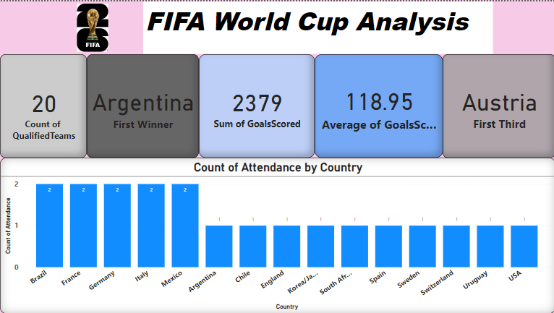
Visualizing the Data

Slide 8
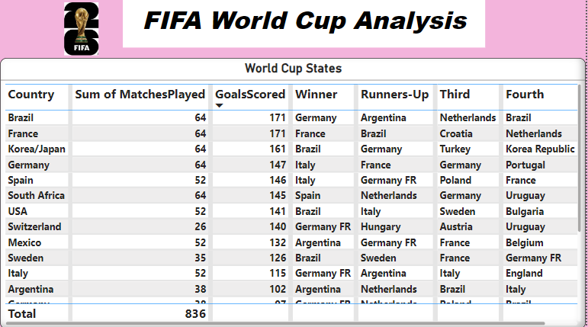
Visualizing the Data

Slide 9
Insights and Data Analysis
-Brazil has qualified for the FIFA World Cup 82 times.
- Italy has qualified for the tournament 57 times.
- Brazil has won 5 matches against Italy, while Italy has won 4 matches.
- Brazil has hosted the World Cup twice, and France has hosted it twice as well.
- In 2014, a total of 32 teams qualified, playing a total of 64 matches.
- The sum of goals scored in the 2014 World Cup is 171.
- Germany recorded the highest attendance among all countries.

Slide 10
Insights and Data Analysis
The stadiums with the most total attendance are Zentralstadio stadium and Estadio Sausalito with 14 attendees each.
It appears that ZSOLT Istvan and ZARATE Venanci are the most frequent assistant referees based on their initials listed multiple times.
Most experienced coaches by teams coached: Mario Zagallo (BRA) coached the most teams (3) throughout his career, followed by Walter Winterbottom (ENG) and Marc Wilmots (BEL) who each coached 2 teams.
Spread of coaching experience: There seems to be a bigger spread of experience among coaches compared to players. The top coach coached 3 teams, whereas the top player only played for 2 teams.
Potentially famous players: The data likely shows how many teams each player has played for throughout their career, not necessarily World Cup teams. Players like Ronaldo and Dida appear on the list, suggesting these might be famous players who played for multiple teams.

Slide 11
Insights and Data Analysis
Top attending countries: The countries with the highest attendance are Germany, Argentina and Brazil, likely due to these countries historically performing well at the World Cup and potentially hosting the tournament.
Host nation advantage: It is possible that the data shows attendance is higher in countries that host the World Cup, but this cannot be confirmed from this image alone.
Brazil's dominance: Brazil has won the most World Cups (5), according to the data. They have also played the most matches (64) and scored the most goals (171).
European contenders: Germany and France are not far behind Brazil in terms of total matches played and goals scored. They have also both won the World Cup multiple times (Germany - 4, France - 2).
Tournament consistency: Brazil and France are the only two teams to appear in both the "Winner" and "Runners-up" columns multiple times. This suggests they have been consistent contenders throughout the World Cup tournaments.

Slide 12
Conclusion
This Power BI dashboard provides a comprehensive analysis of FIFA World Cup results, enabling users to gain valuable insights into historical match data. By leveraging data mining technique and effective visualization, the dashboard facilitates a deeper understanding of tournament dynamics and trends over time.

Slide 13
thank you
KALLURI. GOPI KIRAN

